Slide 1
Web Design Lecture-2D
Instructor: Vishal Chawla

Slide 2

Overview of Forms
Forms are used all over the Web to
Accept information
Provide interactivity
Types of forms:
Search form, Order form, Newsletter sign-up form, Survey form, Add to Cart form, and so on…
Source: Basics of Web Design (HTML5 and CSS3)

Slide 3
Two Components of Using Forms
1. The web page form
An HTML element that contains and organizes form controls such as text boxes, check boxes, and buttons that can accept information from website visitors.
and
2. The server-side processing
Server-side processing works with the form data and sends e-mail, writes to a text file, updates a database, or performs some other type of processing on the server.
Source: Basics of Web Design (HTML5 and CSS3)

Slide 4
HTML Using Forms
<form> tag
Contains the form elements on a web page
Container tag
<input> tag
Configures a variety of form elements including text boxes, radio buttons, check boxes, and buttons
Stand alone tag
<textarea> tag
Configures a scrolling text box
Container tag
<select> tag
Configures a select box (drop down list)
Container tag
<option> tag
Configures an option in the select box
Container tag
Source: Basics of Web Design (HTML5 and CSS3)

Slide 5
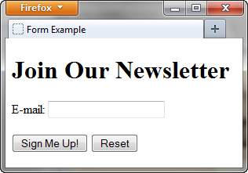
Sample Form HTML
<form>
E-mail: <input type="text" name="email" id="email" >
<br><br>
<input type="submit" value="Sign Me Up!"> <input type="reset">
</form>
Source: Basics of Web Design (HTML5 and CSS3)

Slide 6
The Form Element <form>
Container Tag
The form element attributes:
action
Specifies the server-side program or script that will process your form data
method
get – default value, form data passed in URL
post – more secure, form data passed in HTTP Entity Body
name
Identifies the form
id
Identifies the form
Source: Basics of Web Design (HTML5 and CSS3)

Slide 7

The Input Element Text Box <input>
Accepts text information
Common Attributes:
type=“text”
name
id
size
maxlength
value
required (HTML5)
placeholder (HTML5)
Source: Basics of Web Design (HTML5 and CSS3)

Slide 8

The Input Element Password Box <input>
Accepts text information that needs to be hidden as it is entered
Common Attributes:
type=“password”
name
id
size
maxlength
value
required (HTML5)
placeholder (HTML5)
Source: Basics of Web Design (HTML5 and CSS3)

Slide 9
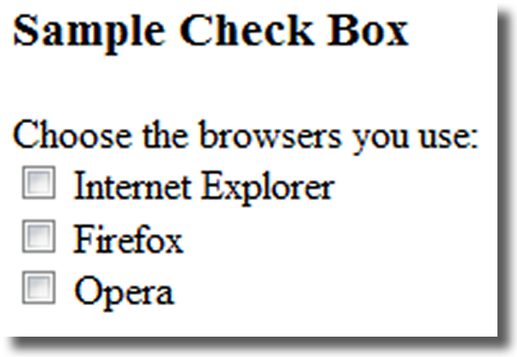
The Input Element Check box <input>
Allows the user to select one or more of a group of predetermined items
Common Attributes:
type=“checkbox”
name
id
checked
value
Source: Basics of Web Design (HTML5 and CSS3)

Slide 10
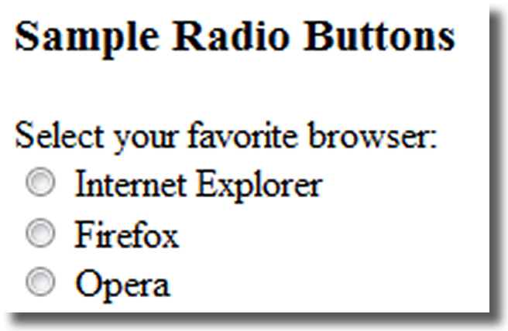
The Input Element Radio Button <input>
Allows the user to select exactly one from a group of predetermined items
Each radio button in a group is given the same name and a unique value
Comon Attributes:
type=“radio”
name
id
checked
value
Source: Basics of Web Design (HTML5 and CSS3)

Slide 11
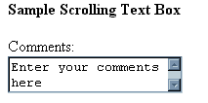
The Textarea Element <textarea>
Configures a scrolling text box
Common Attributes:
name
id
cols
rows
Source: Basics of Web Design (HTML5 and CSS3)

Slide 12

The Select Element <select>
Configures a select list (along with <option> tags)
Also known as: Select Box, Drop-Down List, Drop-Down Box, and Option Box.
Allows the user to select one or more items from a list of predetermined choices.
Common Attributes:
name
id
size
multiple
Source: Basics of Web Design (HTML5 and CSS3)

Slide 13
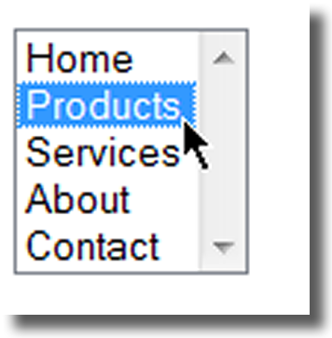
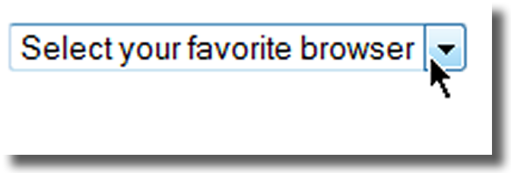
The Option Element <option>
Configures the options in a Select List
Attributes:
value
selected
Source: Basics of Web Design (HTML5 and CSS3)

Slide 14
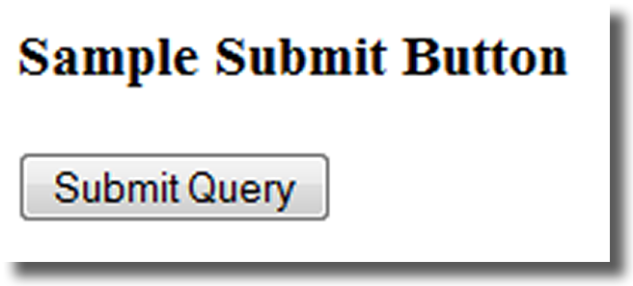
The Input Element Submit Button <input>
Submits the form information
When clicked:
Triggers the action method on the <form> tag
Sends the form data (the name=value pair for each form element) to the web server.
Attributes:
type=“submit”
name
id
value
Source: Basics of Web Design (HTML5 and CSS3)

Slide 15
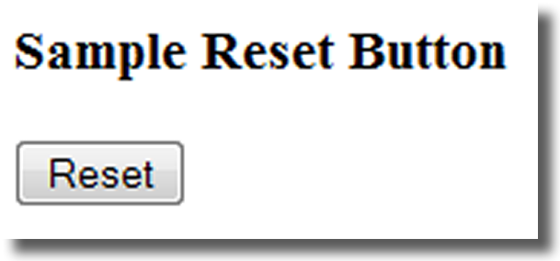
The Input Element Reset Button <input>
Resets the form fields to their initial values
Attributes:
type=“reset”
name
id
value
Source: Basics of Web Design (HTML5 and CSS3)

Slide 16
The Input Element Hidden Field <input>
This form control is not displayed on the Web page.
Hidden form fields
Can be accessed by both client-side and server-side scripting
Common Attributes:
type=“hidden”
name
id
value
Source: Basics of Web Design (HTML5 and CSS3)

Slide 17
The Label Element <label>
Associates a text label with a form control
Two Different Formats: <label>Email: <input type="text" name="CustEmail" id ="CustEmail"></label>
Or <label for="email">Email: </label> <input type="text" name="CustEmail" id= "email" />
Source: Basics of Web Design (HTML5 and CSS3)

Slide 18
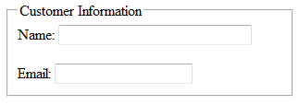
The Fieldset & Legend Elements
The Fieldset Element <fieldset>
Container tag
Creates a visual group of form controls on a web page
The Legend Element <legend>
Container tag
Creates a text label within the fieldset
<fieldset><legend>Customer Information</legend>
<label>Name: <input type="text" name="CName" id="CName" size="30"></label> <br><br >
<label>Email: <input type="text" name="CEmail" id="CEmail"></label>
</fieldset>
Source: Basics of Web Design (HTML5 and CSS3)

Slide 19
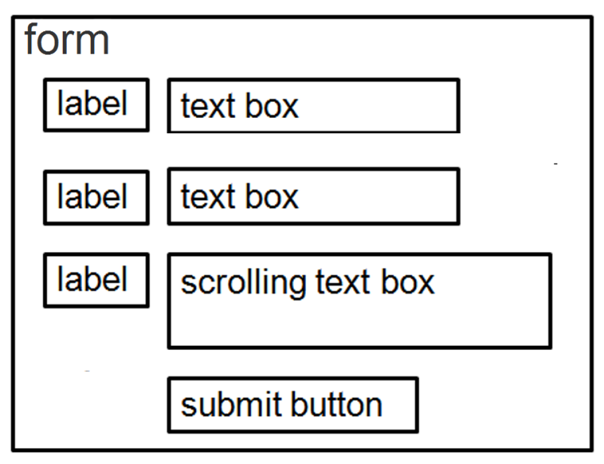
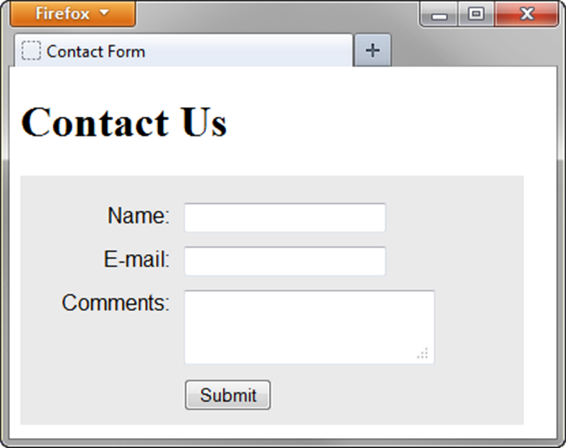
Using CSS to Style a Form
form { background-color:#eaeaea; font-family: Arial, sans-serif;
width: 350px; padding: 10px;}
label { float: left; clear: left; display: block; width: 100px;
text-align: right; padding-right: 10px; margin-top: 10px; }
input, textarea { margin-top: 10px; display: block;}
input[type= "submit"]{ margin-left: 110px; }
Source: Basics of Web Design (HTML5 and CSS3)

Slide 20
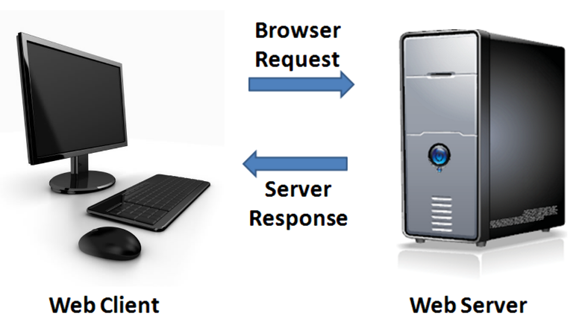
Server-Side Processing
Your web browser requests web pages and their related files from a web server.
The web server locates the files and sends them to your web browser.
The web browser then renders the returned files and displays the requested web pages for you to use.
Source: Basics of Web Design (HTML5 and CSS3)

Slide 21
Server-Side Scripting
One of many technologies in which a server-side script is embedded within a web page document saved with a file extension such as:
.php (PHP)
.cfm (Adobe ColdFusion)
.jsp (Sun JavaServer Pages)
.aspx (ASP.Net).
Uses direct execution — the script is run either by the web server itself or by an extension module to the web server.
Source: Basics of Web Design (HTML5 and CSS3)

Slide 22
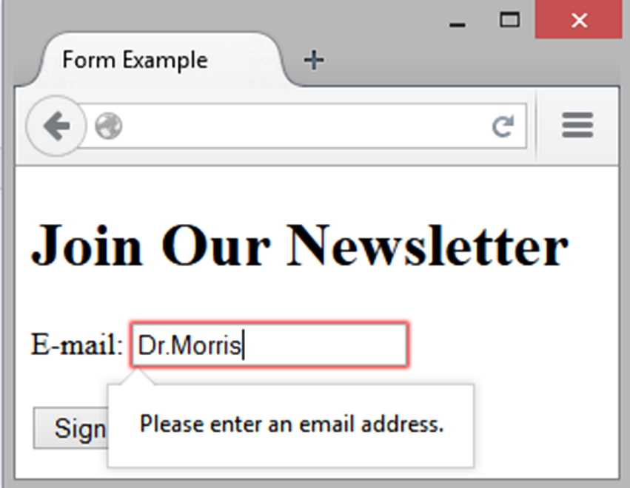
HTML5: Email Text Box <input>
Accepts text information in e-mail address format
Common Attributes:
type=“email”
name
id
size
maxlength
value
placeholder
required
Source: Basics of Web Design (HTML5 and CSS3)

Slide 23
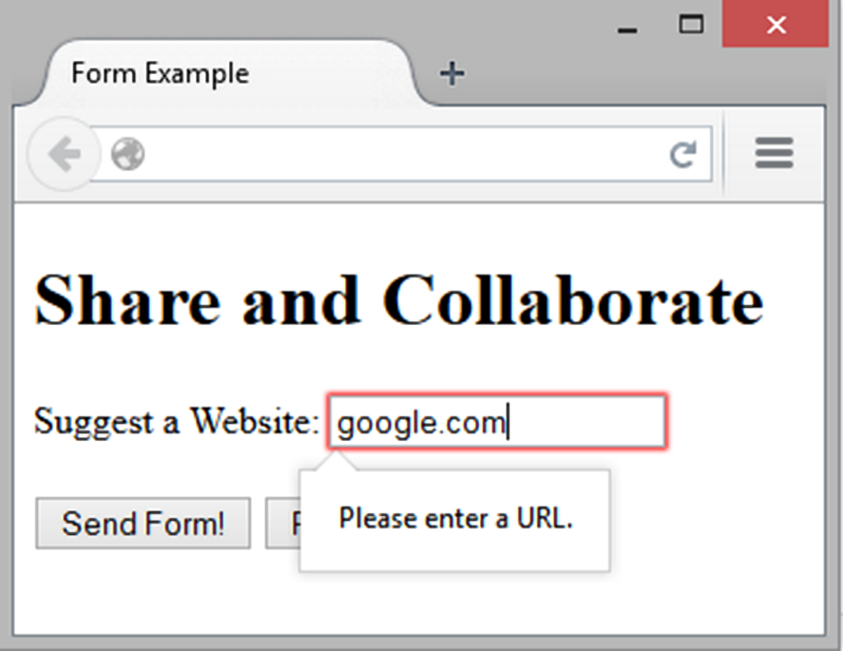
HTML5: URL Text Box <input>
Accepts text information in URL format
Common Attributes:
type=“url”
name
id
size
maxlength
value
placeholder
required
Source: Basics of Web Design (HTML5 and CSS3)

Slide 24
HTML5: Telephone Number Text Box <input>
Accepts text information in telephone number format
Common Attributes:
type=“tel”
name
id
size
maxlength
value
placeholder
required
Source: Basics of Web Design (HTML5 and CSS3)

Slide 25
HTML5: Search Text Box <input>
Accepts search terms
Common Attributes:
type=“search”
name
id
size
maxlength
value
placeholder
required
Source: Basics of Web Design (HTML5 and CSS3)

Slide 26
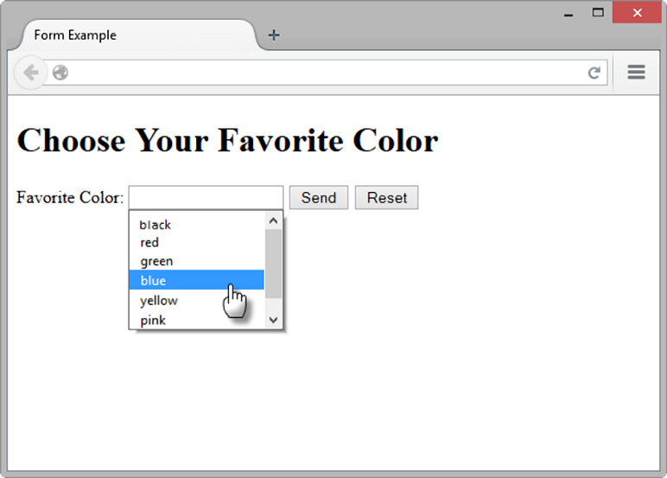
HTML5: Datalist Control
<label for="color">Favorite Color:</label> <input type="text" name="color" id="color" list="colors" >
<datalist id="colors">
<option value="red">
<option value="green">
<option value="blue">
<option value="yellow">
<option value="pink">
<option value="black">
</datalist>
Source: Basics of Web Design (HTML5 and CSS3)

Slide 27
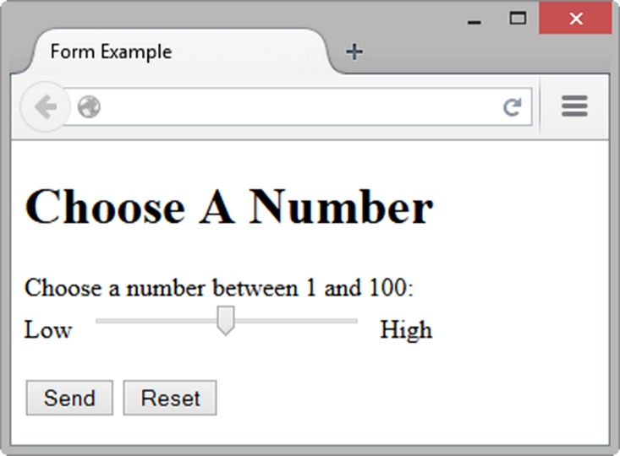
HTML5: Slider Control <input>
<label for="myChoice">
Choose a number between 1 and 100:</label><br>
Low <input type="range" name="myChoice" id="myChoice"> High
Source: Basics of Web Design (HTML5 and CSS3)

Slide 28
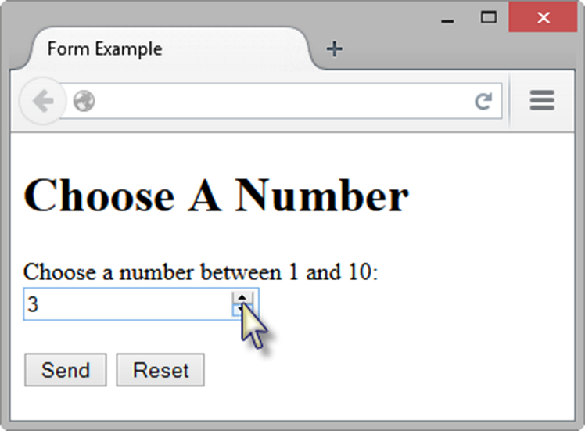
HTML5: Spinner Control <input>
<label for="myChoice">Choose a number between 1 and 10:</label> <input type="number" name="myChoice" id="myChoice"
min="1" max="10">
Source: Basics of Web Design (HTML5 and CSS3)

Slide 29
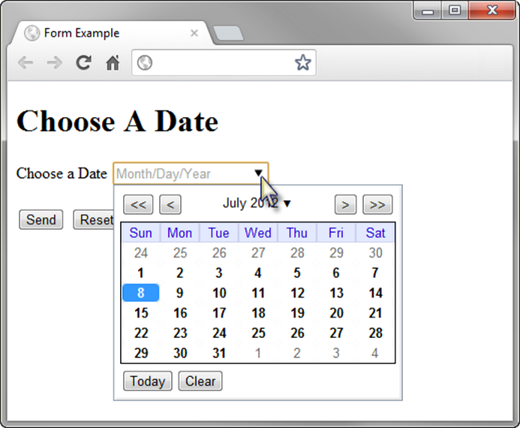
HTML5: Calendar Control <input>
<label for="myDate">Choose a Date</label> <input type="date" name="myDate" id="myDate">
Source: Basics of Web Design (HTML5 and CSS3)

Slide 30
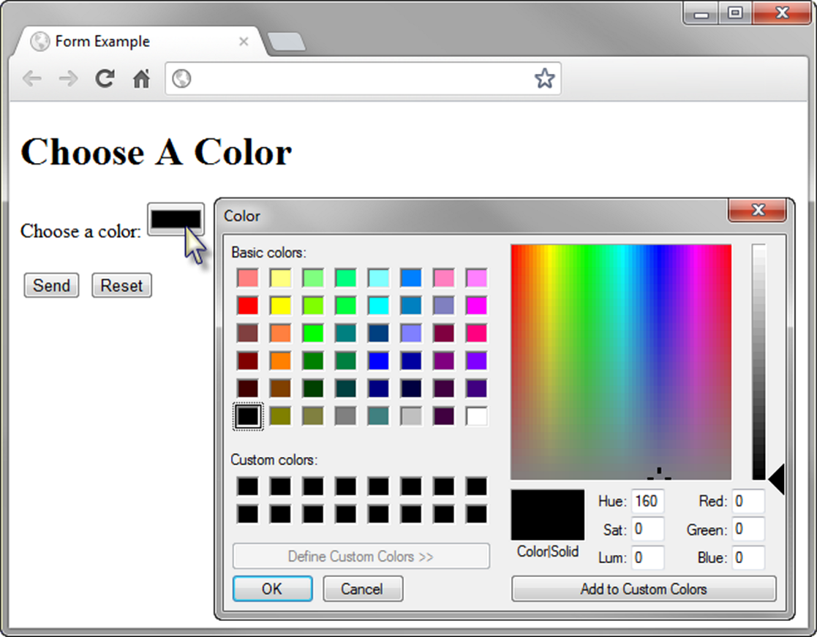
HTML5 Color-well Control
<label for="myColor">Choose a color:</label>
<input type="color" name="myColor" id="myColor">
Source: Basics of Web Design (HTML5 and CSS3)

Slide 31
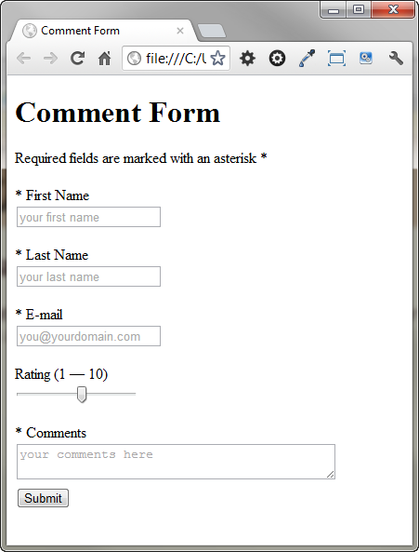
Practice with an HTML5 Form
The form display and functioning varies with browser support.
Source: Basics of Web Design (HTML5 and CSS3)

